Slide 1
ML for Retail: Predicting Customer Spending and Product Sales
Kendall Barber-Mayo
December 2018
Supervised Learning Capstone

Slide 2
Research Questions:
Can we use customer demographics and product meta data to predict how much each customer will spend?
Can we use customer demographics and product meta data to predict the sales of each product?
Are there insights we can provide our marketing team to increase marketing ROI?
Are there demand insights that we can provide to our Supply Chain team to help increase accuracy in labor and product stock predictions?

Slide 3
Dataset - 2017 Black Friday Sales
537,577 transactions were recorded during this day
There are 3,623 unique products and 18 unique product categories. Up to three different Categories can represent a product.
There are 5891 unique customers, characterized by age group, gender, city, tenure in city, occupation and marital status

Slide 4
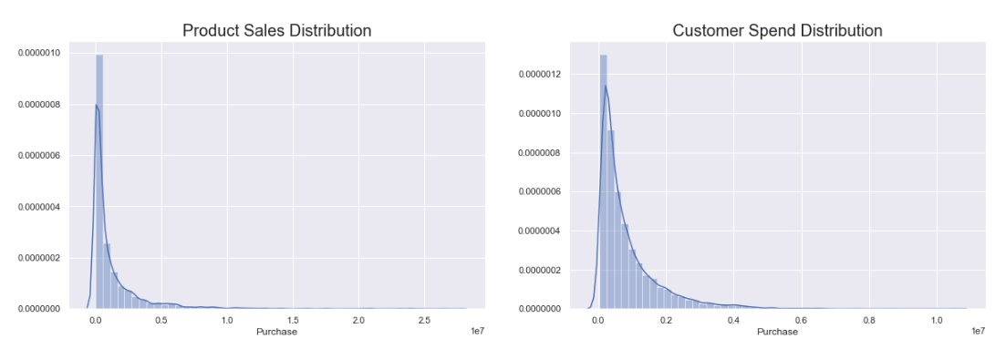
Target Variables - Product Sales and Cutomer Spend

Slide 5
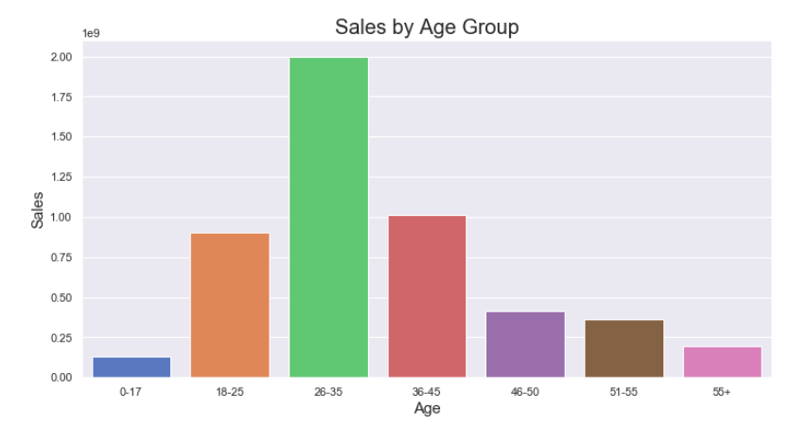
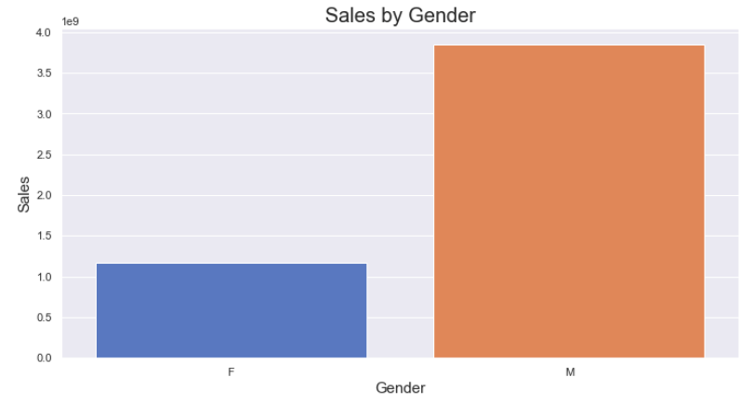
Sales: By Age Group & Gender

Slide 6
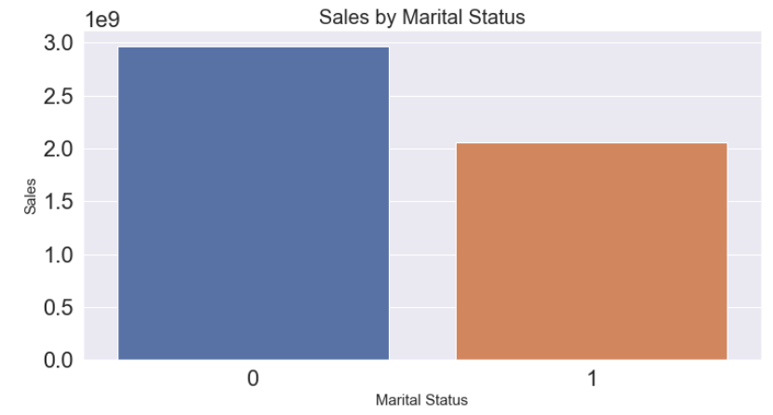
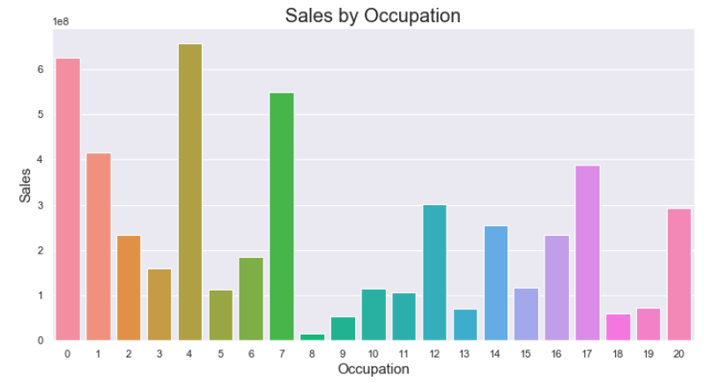
Sales: By Marital Status and Occupation

Slide 7
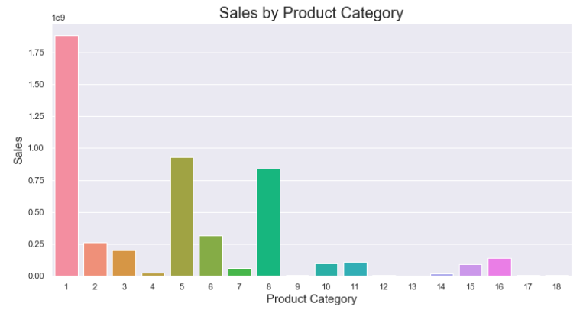
Product Category Sales

Slide 8
Feature Engineering

Slide 9
Feature Engineering - Creating Dataframes
Variables for Predicting Product Sales:
Age Count and percentage
Gender Count and percentage
Product Category Count
Product Category Dummies
Occupation Count and percentage
Stay_in_Current_City_years Count and percentage
Marital Status Count and percentage
City Count and percentage
How many users bought product
Variables for Predicting Customer Spend:
Age and Age Dummies
Gender and Gender Dummies
Category Count
Category Dummies
Occupation and Occupation Dummies
Stay_in_Current_City_years and Stay_Current_City_dummies
Marital Status
City and City Dummies

Slide 10
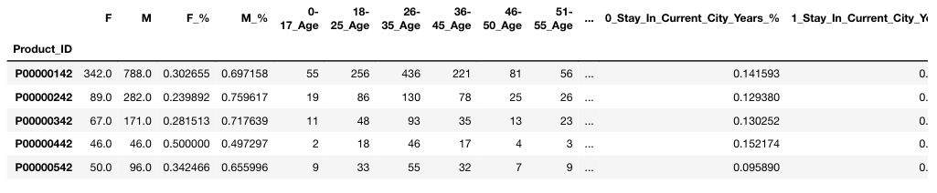
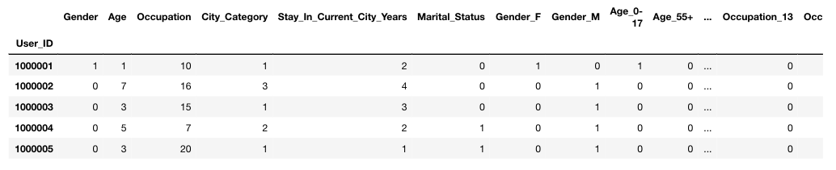
Feature Engineering - Creating Dataframes

Slide 11
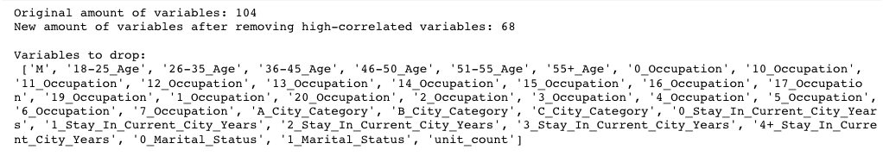

Feature Engineering - Variable Selection
Check for and Drop Highly Correlated Variables
Predicting Product Sales: Variables Dropped
Predicting Customer Spend: Variables Dropped

Slide 12
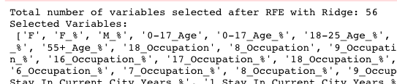
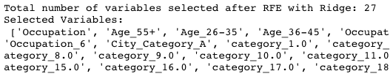
Feature Engineering - Variable Selection
Recursive Feature Elimination - Ridge vs. Random Forest estimator
Ridge
Random Forest
Predicting Product Sales
Predicting Customer Spend

Slide 13
Modeling
Ridge Regression
Random Forest Regression
Gradient Boost Regression
Predicting Product Sales and Customer Spend

Slide 14
74.9% / 97.2%
Product Sales
Customer Spend
Ridge Regression Optimized Scores
Pros:
Guards against overfitting
Feature importance is easy to explain via Coefficients
Computationally inexpensive
Cons:
Variables must be standardized/normalized
Assumes Linear Relationship
Parameters Optimized:
Alpha
Fit intercept
Solver
RFE-Random Forest variables performed better when Predicting Product Sales. The opposite is true for predict Customer Spend
Notes:
Add Section for Plus and Minuses of Using Model, Add Section to Talk About Differences Between Scores, Add Section to talk about optimized parameters

Slide 15
88.9% / 95.8%
Product Sales
Customer Spend
Random Forest Regression Optimized Scores
Pros:
Does not assume normality or linear relationship
Robust - Accurate
Guards against overfitting - when optimized
Cons:
Computationally expensive
Black Box
Parameters Optimized:
N estimator
Criterion
RFE-Random Forest variables performed better when predicting Product Sales and Customer Spend
Notes:
Add Section for Plus and Minuses of Using Model, Add Section to Talk About Differences Between Scores, Add Section to talk about optimized parameters

Slide 16
88.9% / 95.8%
Product Sales
Customer Spend
Gradient Boost Regression Optimized Scores
Pros:
Does not assume normality or linear relationship
Robust - Accurate
Guards against overfitting - when optimized
Cons:
Computationally expensive
Black Box
Can be prone to overfitting
Parameters Optimized:
Loss
Alpha
N estimators
Max Features
RFE-Random Forest variables performed better when predicting Product Sales and Customer Spend
Notes:
Add Section for Plus and Minuses of Using Model, Add Section to Talk About Differences Between Scores, Add Section to talk about optimized parameters

Slide 17
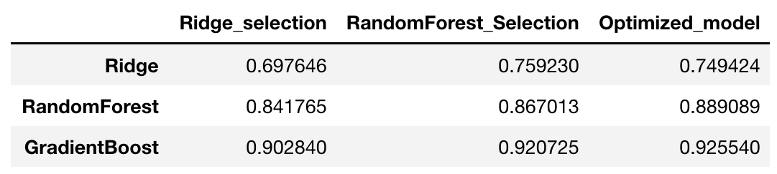
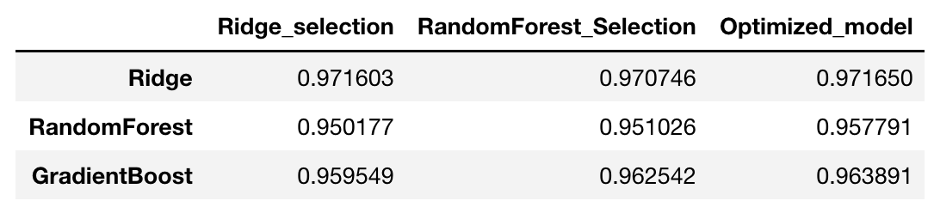
Summary Tables
Product Sales
Customer Spend

Slide 18
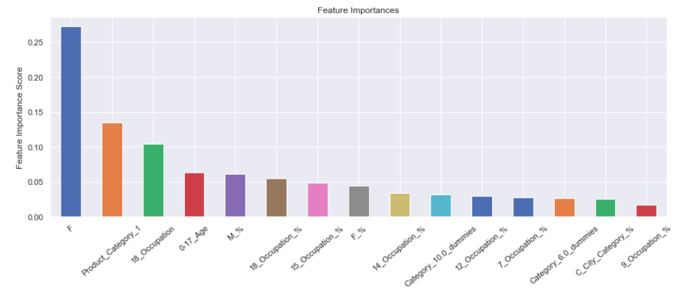
Feature Importance - Product Sales

Slide 19
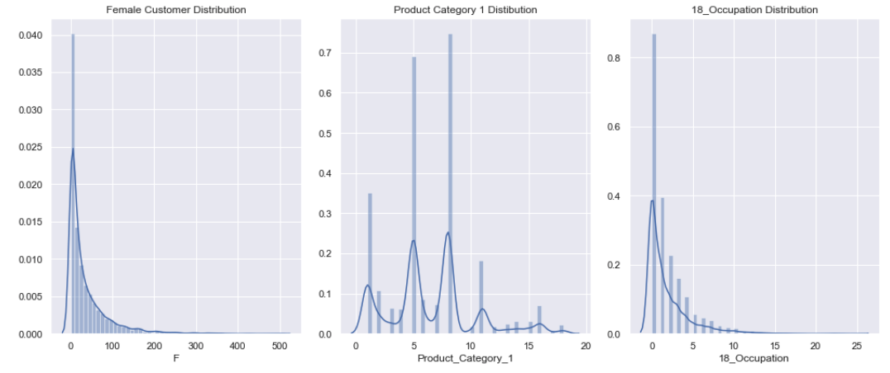
Feature Importance - Product Sales

Slide 20
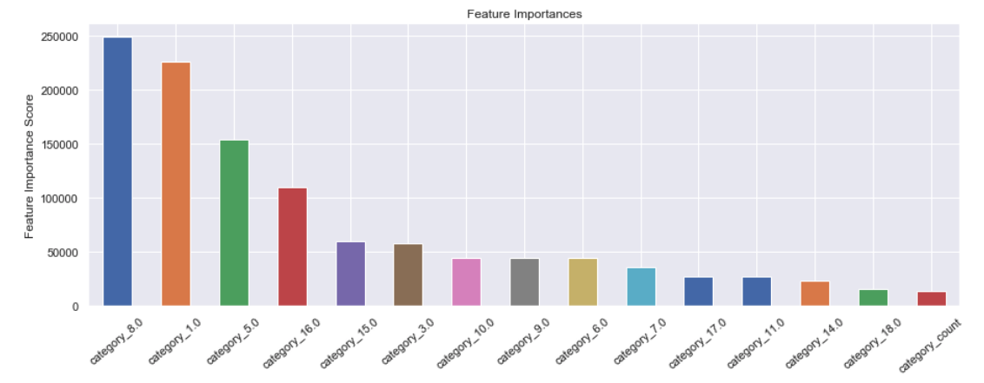
Feature Importance - Customer Spend

Slide 21
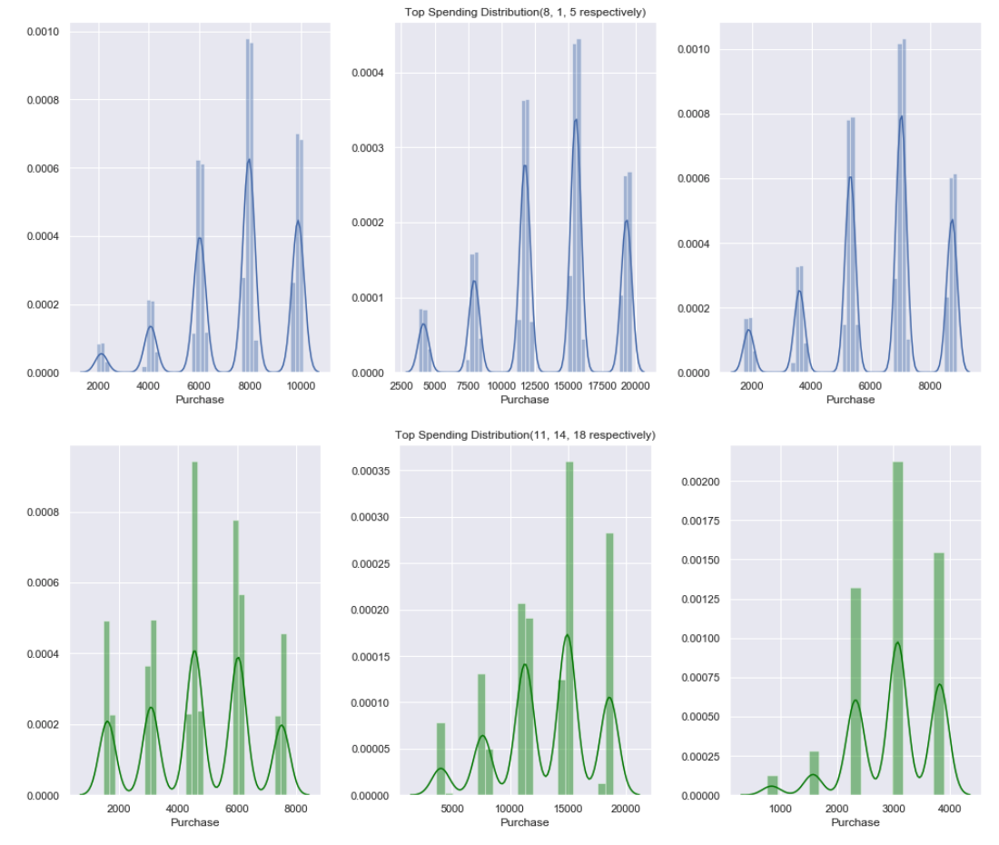
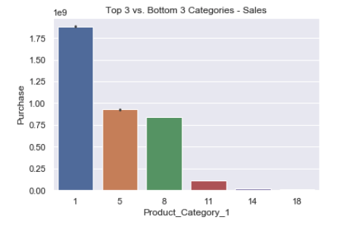
Feature Importance - Customer Spend

Slide 22
Conclusion
Target audience via Data Exploration: within 26-35 age group, male, non-married and have an occupation within 0, 4 or 7 occupation groups
If we can predict product sales, then we can predict product stock levels - This will help to decrease the amount of stock we have left over after black friday sales, which will help to decrease expenses and increase profits.
Customer Spend model can be used by our marketing team to help determine marketing strategy and output. With this model, the marketing team can determine how much money we should spend on each customer group by determining the marketing ROI.

Slide 23
Further Exploration
If we chose which customer demographics we wanted to use to predict customer spend, would it be accurate?
If we chose which product meta-data we wanted to use to predict product sales, would it be accurate?
Could we build a model that would predict customer spend/product sales for any day throughout the year? How would time affect the models accuracy?

Slide 24
Thank You!
Jupyter Notebook

